Slide 1
Vocabulary
Unit 1 Key Terms

Slide 2
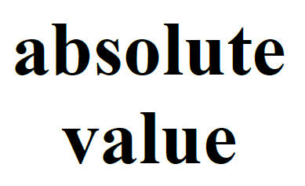
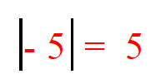
The distance of a number from zero on the number line.
Anything inside the Absolute Value bars is always positive!

Slide 3
A pair of numbers that gives an exact location on a coordinate plane. The x value tells the position of the point on the x-axis. The y value tells the position of the point on the y-axis.

Slide 4
An area where the x-axis and the y-axis intersect at the origin.
Coordinate Pairs (x, y) are plotted on the Coordinate Plane.

Slide 5
Greater Than is used to compare two numbers in an inequality statement when the first number is larger than the second number.

Slide 6
inequality Statement
8 > -2
A math sentence that compares two unequal numbers or expressions using one of the symbols: <, >, <, > or ≠

Slide 7
A fancy way to say Whole Number.
Integers can be positive or negative whole numbers.
The number zero is also an integer.

Slide 8
Less Than is used to compare two numbers in an inequality statement when the first number is smaller than the second number.

Slide 9
The four sections of a coordinate plane that are created by the intersection of the x-axis & the y-axis.

Slide 10
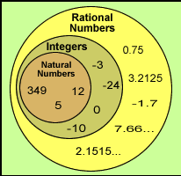
rational
numbers
All real numbers including positive and negative integers, 0, fractions & decimals.
Rational Numbers can be rewritten as a fraction of two integers, a terminating decimal or a repeating decimal.

Slide 11
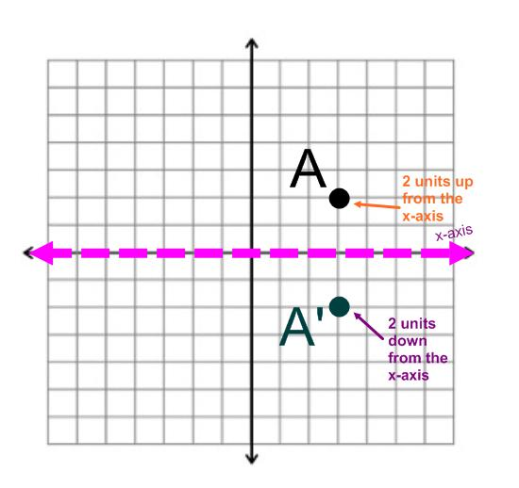
reflection
Reflection is a mirror view of a point on the coordinate plane that is the same distance from the x-axis & the y-axis, but in a different quadrant.

