Slide 1
Statistics
Collecting → Describing→ Summarizing

Slide 2
What is Statistics?
Statistics is a set of data (information) that has been collected.
The data can be categorical or numerical.
Categorical Data – Information that can be sorted into groups/categories.
Ex: Favorite colors (Blue, Red, Purple, Green, etc.)
Numerical Data – Information that is in numbers.
Ex: How many DVDs do you own? (5, 12, 316)
How tall are your classmates? (60 in, 55 in)

Slide 3
Who Uses Statistics?
Everyone uses statistics!
Yes… YOU, even!
Everyone is influenced by statistics!
Yes… YOU, even!
Everyone survives because of statistics!
Yes… YOU, even!
Not sure about that?

Slide 4
Why are there two or three versions of these games?

Slide 5
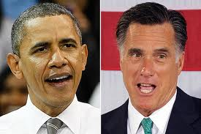
Why is Obama the President?

Slide 6
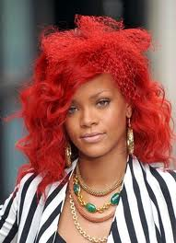
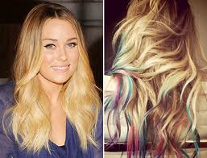
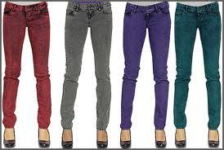
Why do you choose fly hairstyles or cute pants?

Slide 7
3 Stages of Statistics
Collecting
Ask a statistical question
Record observations accurately
Representing
Organize data into a table/chart
Choose the best graph to later interpret
Summarizing
Determine the best measure of distribution (center or variation)
Make conclusions within the context of the data

Slide 8
Step One: Collecting
You have got to ask a statistical question, if you really want to get the info!
What makes a question statistical?
1. A specific population .
2. Topic of interest .
3. MOST IMPORTANT: Variability in the responses .

Slide 9
Organize Your Data
1) Order the numerical data from least to greatest.
2) Put your data in a chart or table.

Slide 10
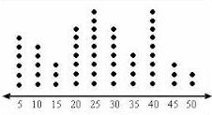
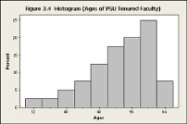
Step Two: Representing
Type of Graph When To Use Example/Picture
Dot Plot Represents data on a
number line using dots.
Box &
Whiskers Plot Shows the distribution of data
on a number line.
Histogram A special type of bar graph that
shows the frequency of
data in intervals!

Slide 11
Bar Graph vs Histogram
Check out this discussion between teacher and students as to the difference between bar graphs & histograms….
http://www.shodor.org/interactivate/discussions/HistogramsVsBarGraph/

Slide 12
Tallest Men Alive
Check out this random interesting article about tallest men in the world….
http://top10hm.com/top-10-tallest-man-alive/

Slide 13
Box & Whiskers Plot
Is a good way to summarize and
better interpret a lot of numerical data.
Check out the video to learn more about Box & Whiskers Plots. There are practice questions, too!
Box & Whiskers Plot Instructional Video

Slide 14
Step Three: Summarizing
There are two ways to interpret data.
1) Measures of Center: One number that describes how the data is most typical. (Most alike)
Ex: Mean; Median; Mode
2) Measures of Variability: One number that describes how the data spreads out (is different).
Ex: Range; IQR; MAD

Slide 15
Mean, Median, MAD… Oh, IQR!
The average 6th grade boy is:
11 ½ years old
4’ 7”
81 lbs
The average 6th grade girl is:
11 ½ years old
4’ 8”
87 lbs
Wait a minute! This doesn’t describe each of you…
so how am I able to say this?

Slide 16
Measures of Central Tendency
When a lot of data represents one specific population, there has to be a way to describe it easily.
Looking around the classroom, we do not all look the same. We are all different.
BUT…
If we had to describe what we look like in ONE way, we would look for patterns and describe us that way.

Slide 17
Measures of Central Tendency
Measure When to Use It How To Use It
Mean when looking for the sum of all the numbers . typical or average amount of numbers added
Median the data set has outliers the middle value when the
data is in order from least to greatest

Slide 18
Measures of Variability
Measure When to Use How To Use
Range To find the spread of data; order the data from
to check variation of data smallest to largest
IQR To find the range of only upper quartile
(inner quartile range) the majority of the data set – lower quartile
to check how much the
M.A.D. data deviates (differs) Click here to find out how
from the central tendency

