Slide 1
Distributive Property
Break It Down!

Slide 2
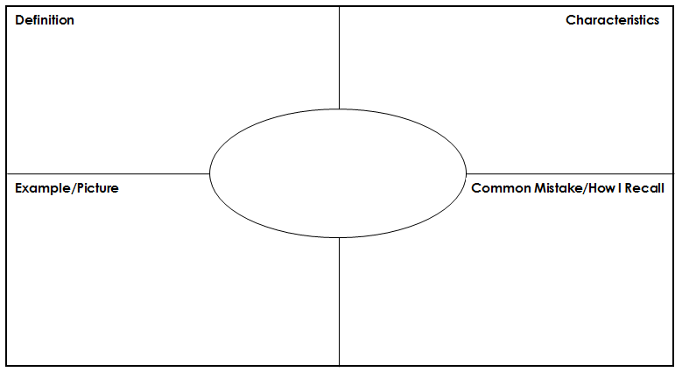
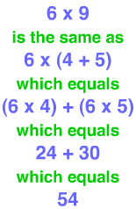
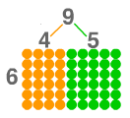
Definition of distributive property
A product can be rewritten as the sum of two products or the difference between two products.
*The rewritten products are factors of the original numbers.
*The original product is equal to
the sum/difference of the
new products.
Distributive Property
Students often only multiply the first number in the parentheses.
6(4 + 5) ≠ 6(4) + 5

Slide 3
Uses for the Distributive Property Works
Multiplication
8 x 7 = ?
7 = 5 + 2
So…
8 x (5 + 2)
+
40 + 16
56
Step by Step
Break down one of the numbers into a sum of two smaller numbers.
Then multiply each of the smaller numbers by the multiplier.
*Keep the operation the same.
8(5)
8(2)

Slide 4
Uses for the Distributive Property Works
Multiplication
8 x 9 = ?
9 = 10 - 1
So…
8 x (10 - 1)
80 – 8
72
Step by Step
Break down one of the numbers into a difference of two smaller numbers.
Then multiply each of the smaller numbers by the multiplier.
*Keep the operation the same.
8(10)
-
8(1)

Slide 5
Uses for the Distributive Property Works
Addition of two numbers
72 + 24 = ?
2 is a common factor of 72 & 24.
72 ÷ 2 = 36
24 ÷ 2 = 12
2 x (36 + 12)
Step by Step
Factor out a common factor from the two numbers.
You will need the common factor and the dividends.
Rewrite the initial sum as a product of two numbers using the common factor and the dividends.
The common factor goes outside the parentheses. The quotients go inside the parentheses

Slide 6
Gold digger & the Distributive Property
You can use the Gold Digger for the distributive property!
Factor the expression
24 + 36
* Factor as if you want to find the Greatest Common Factor.
÷
24
36
2
12
18
2
6
9
3
2
3

Slide 7
Gold digger & the Distributive Property
24 + 36
Multiply down for the common factor you want to use.
Then use the quotients next to the factor to rewrite the problem.
2(12 + 18)
4(6 + 9)
12(2 + 3)
÷
24
36
2
12
18
4
x
2
6
9
12
x
3
3
2
3

Slide 8
Check your work
24 + 36
24 + 36 = 60
2 X (12 + 18)
24 + 36 = 60
2 x (12 + 18)
24 + 36 = 60
2 x (12 + 18)
24 + 36 = 60

Slide 9
Gold digger & the Distributive Property
You can use the Gold Digger for the distributive property!
Factor the expression
12 + 6
* Factor as if you want to find the Greatest Common Factor.
÷
12
6
2
6
3
3
2
1

Slide 10
Gold digger & the Distributive Property
12 + 6
Multiply down for the common factor you want to use.
Then use the quotients next to the factor to rewrite the problem.
2(6 + 3)
6(2 + 1)
÷
12
6
2
6
3
6
x
3
2
1

Slide 11
Check your work
12 + 6
12 + 6 = 18
2 X (6 + 3)
12 + 6 = 18
6 x (2 + 1)
12 + 6 = 18

Slide 12
Gold digger & the Distributive Property
You can use the Gold Digger for the distributive property!
Factor the expression
24 + 60
* Factor as if you want to find the Greatest Common Factor.
÷
24
60
2
12
30
2
6
15
3
2
5

Slide 13
Gold digger & the Distributive Property
24 + 60
Multiply down for the common factor you want to use.
Then use the quotients next to the factor to rewrite the problem.
2(12 + 30)
4(6 + 15)
12(2 + 5)
÷
24
60
2
12
30
4
x
2
6
15
12
x
3
3
2
5

Slide 14
Check your work
24 + 60
24 + 60 = 84
2 X (12 + 30)
24 + 60 = 84
4 x (6 + 10)
24 + 60 = 84
12 x (12 + 30)
24 + 60 = 84

Slide 15
Now, You Try!
Factor the expression
30 + 45
÷
30
45
3
10
15
15
(2 + 3)
x
15
5
2
3

