Slide 1
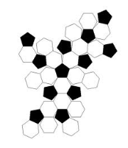
3D Figures and Nets

Slide 2
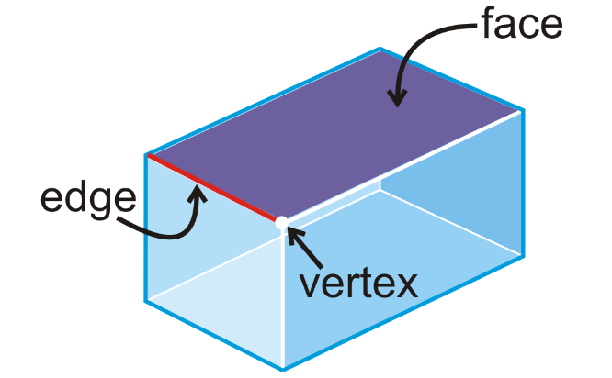
Parts of a Polyhedron
Remember:
A polyhedron
is a 3D figure
made up of
polygons.

Slide 3
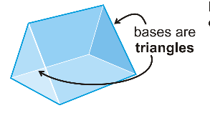
Different Types of Faces
Remember that lateral means ‘side,’ so the lateral faces are the faces on the side of the polyhedron.
The shapes that define the polyhedron are also called bases. For example, the polyhedron below is called a triangular prism because the bases are triangles.
The face that the polyhedron ‘stands on’ is called the base.

Slide 4
Net
A Net is how a 3D figure looks when it is unfolded into a 2D shape.

Slide 5
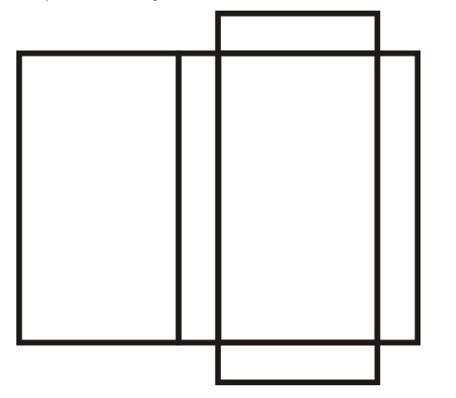
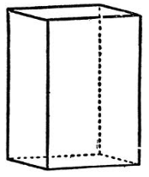
Rectangular Prism
3 Dimensional
Net
6 Faces
12 Edges
8 Vertices

Slide 6
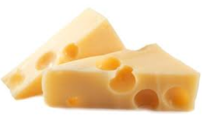
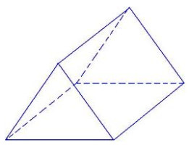
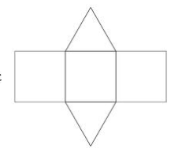
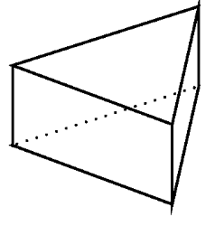
Triangular Prism
3 Dimensional
Net
5 Faces
9 Edges
6 Vertices

Slide 7
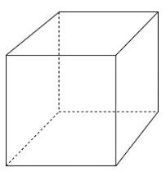
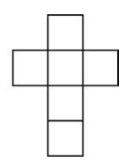
Square Prism (CUBE)
3 Dimensional
Net
6 Faces
12 Edges
8 Vertices
I’m a cube, too!
Ice Cube

Slide 8
Which one is incorrect?

Slide 9
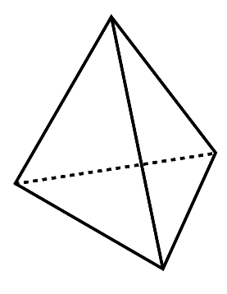
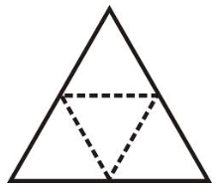
Triangular Pyramid
3 Dimensional
Net
4 Faces
6 Edges
4 Vertices

Slide 10
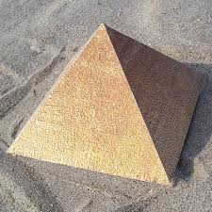
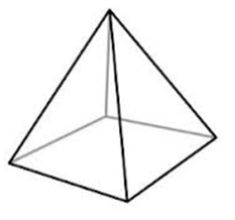
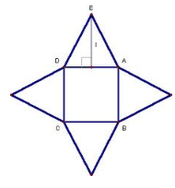
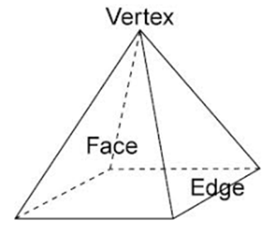
Square Pyramid
3 Dimensional
Net
5 Faces
8 Edges
5 Vertices

Slide 11
Is It a Prism or a Pyramid?
The most common mistake students make is to mix up the prism and the pyramid.
They call a triangular prism a triangular pyramid, and they call a triangular pyramid a triangular prism.
Let’s avoid that mistake now… What is the difference between a prism and a pyramid?
The pyramid only has one base!
The prism
has two bases!
BASE

